Slide 1
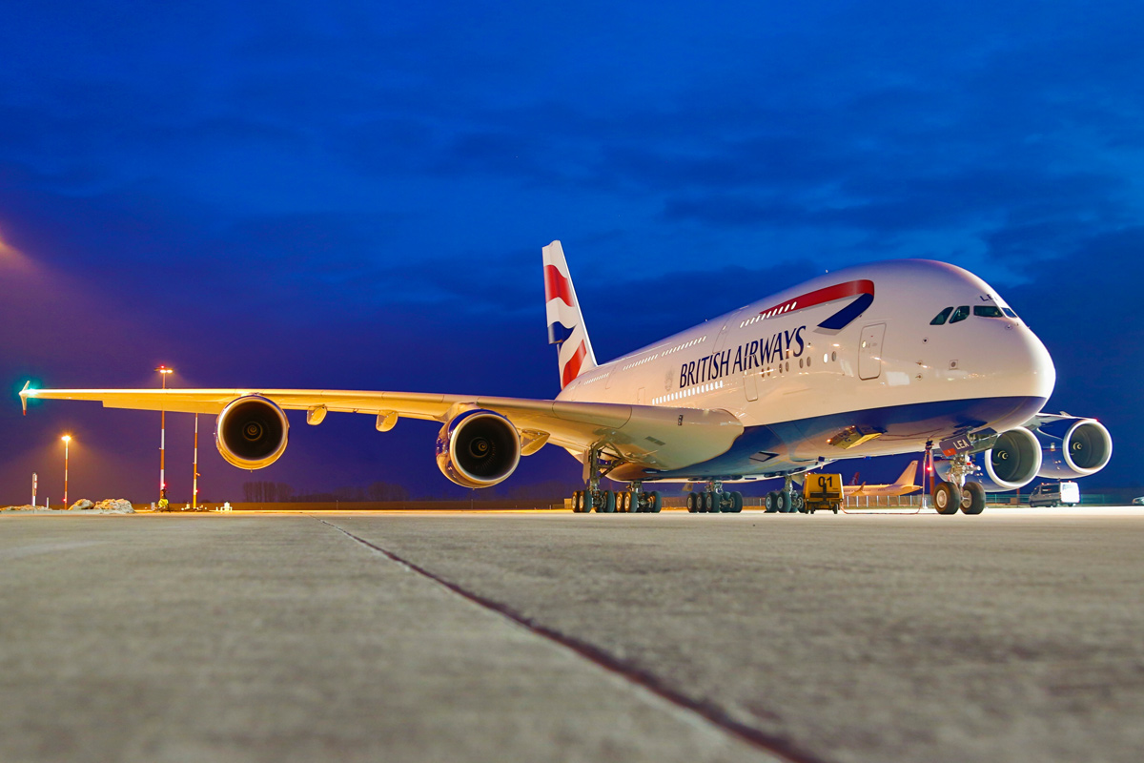
Skynet Aircraft Use Case
Double Deckers
January 2017

Slide 2
Question
Identify top 3 aircrafts’ types for immediate sales opportunities
© 2016 Think Big, a Teradata Company

Slide 3
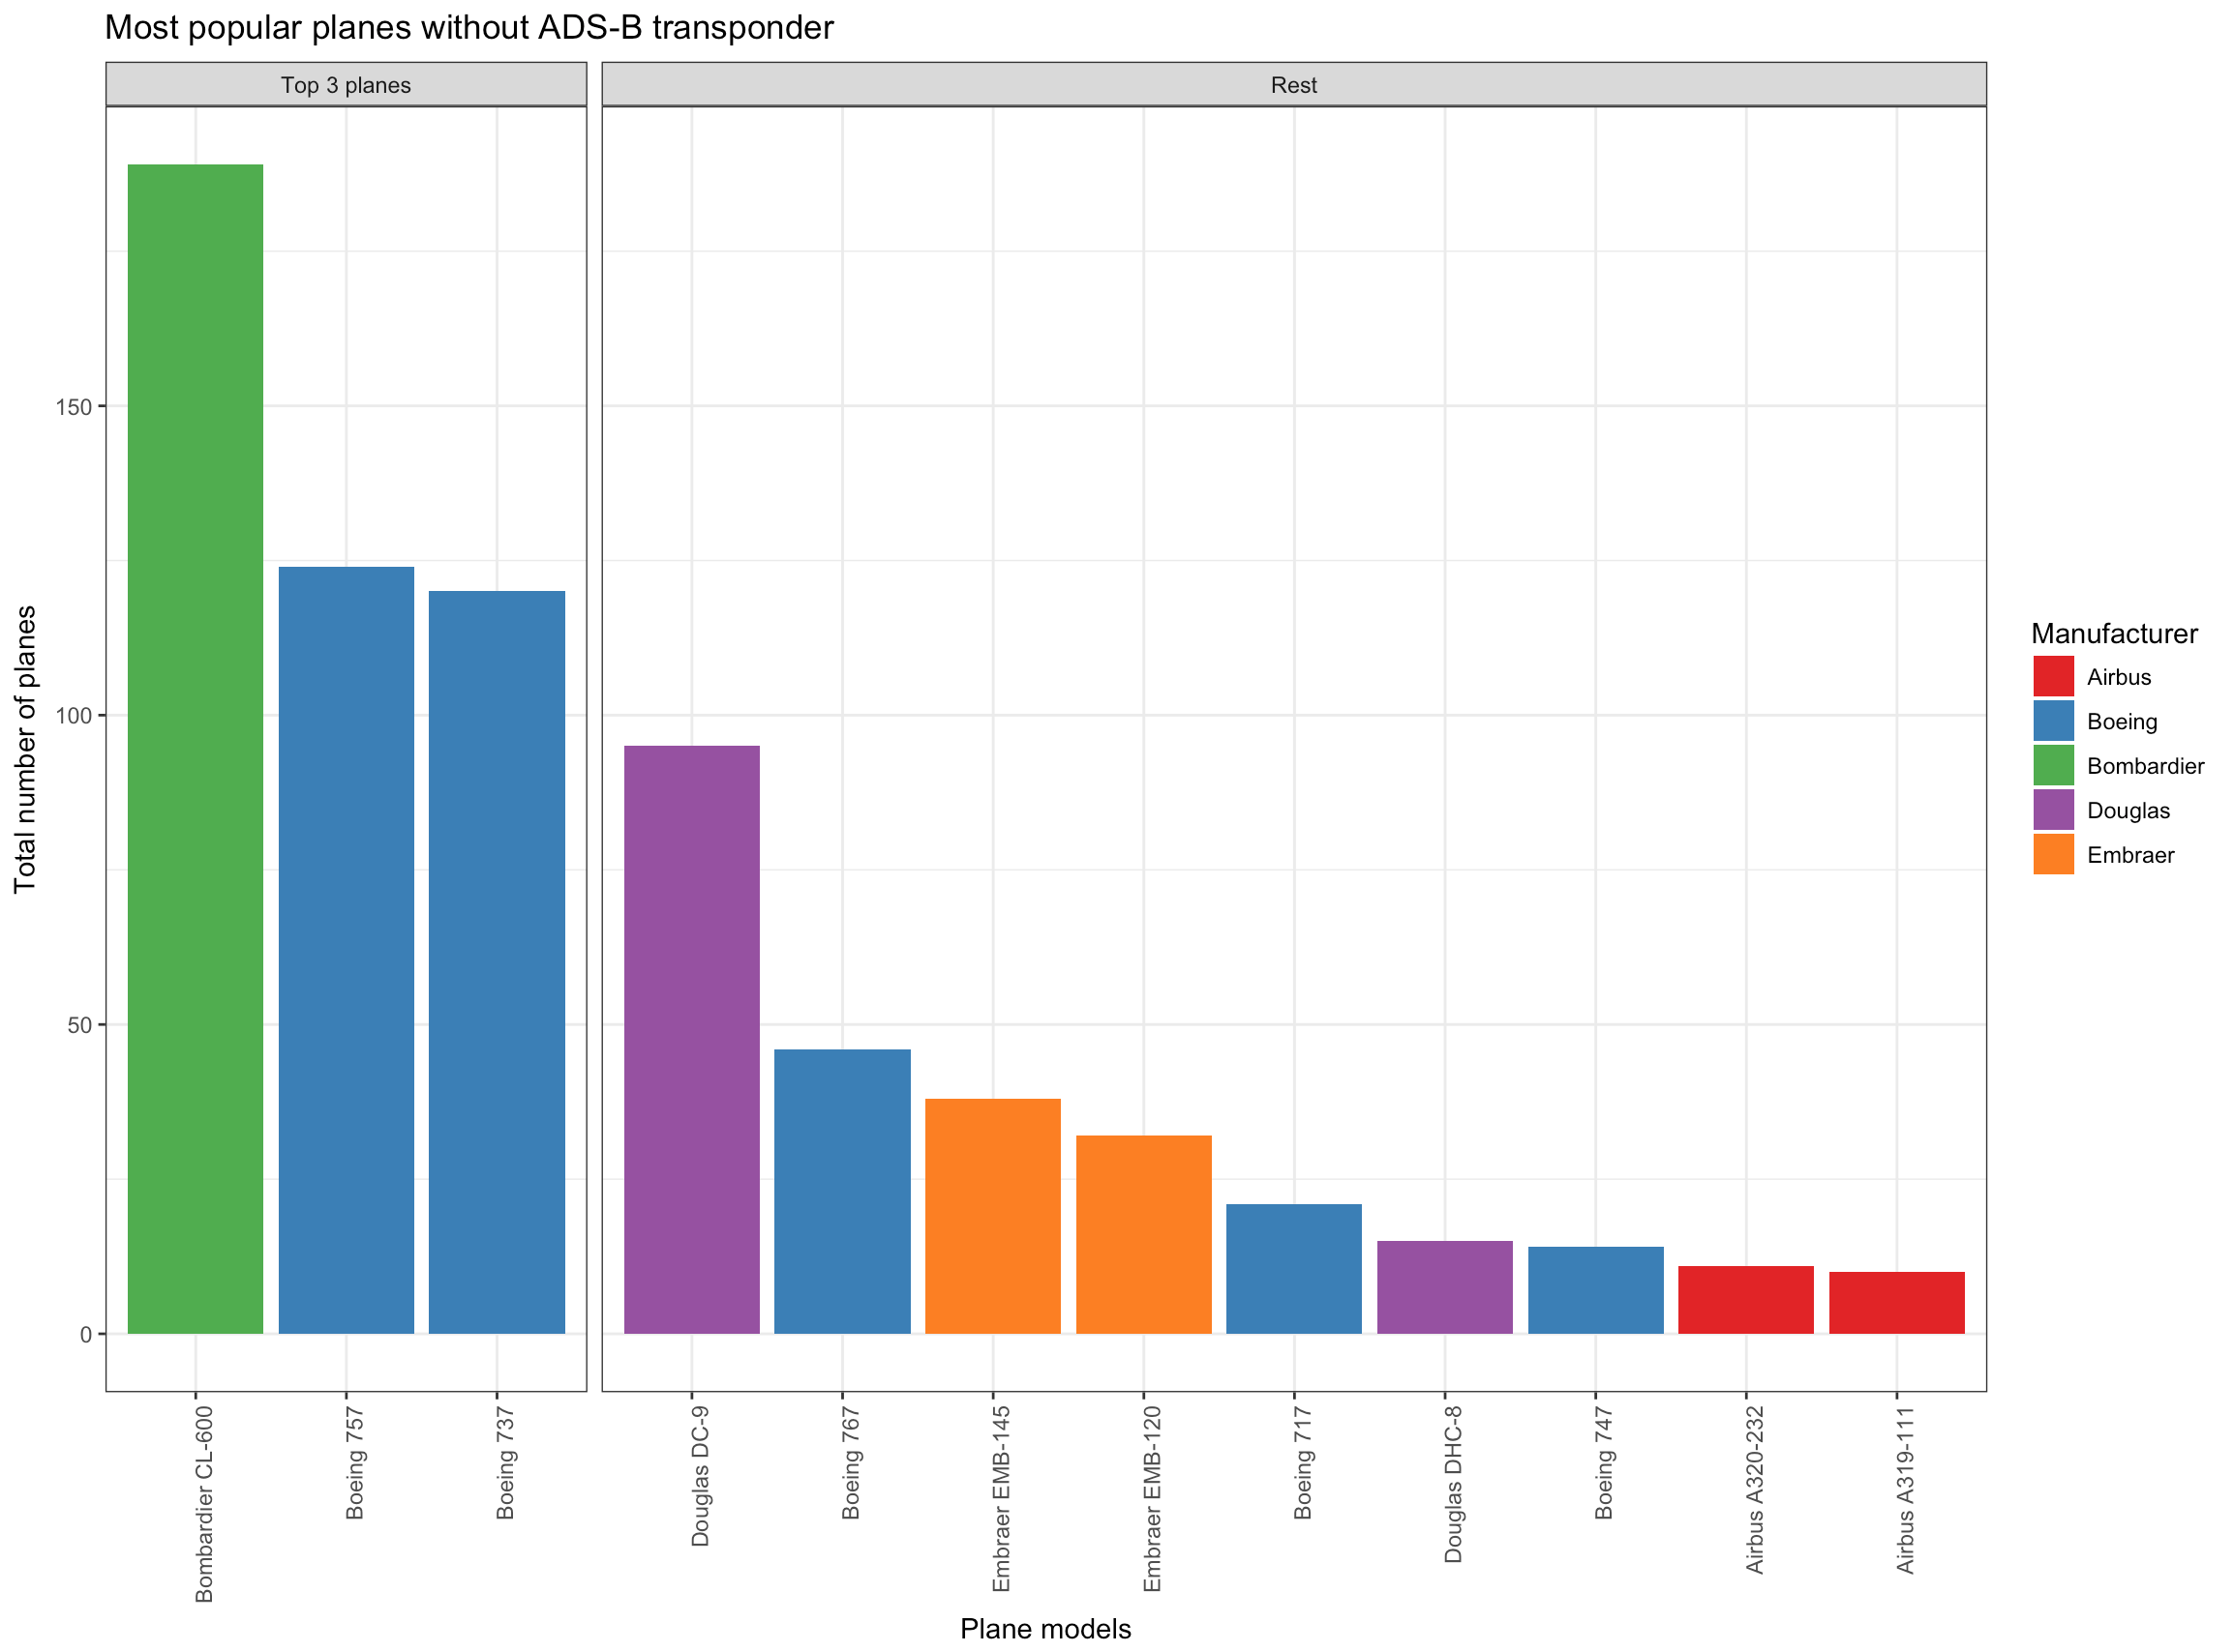
Top Aircrafts
Bombardier CL-600
Boeing 757
Boeing 737
© 2016 Think Big, a Teradata Company

Slide 4
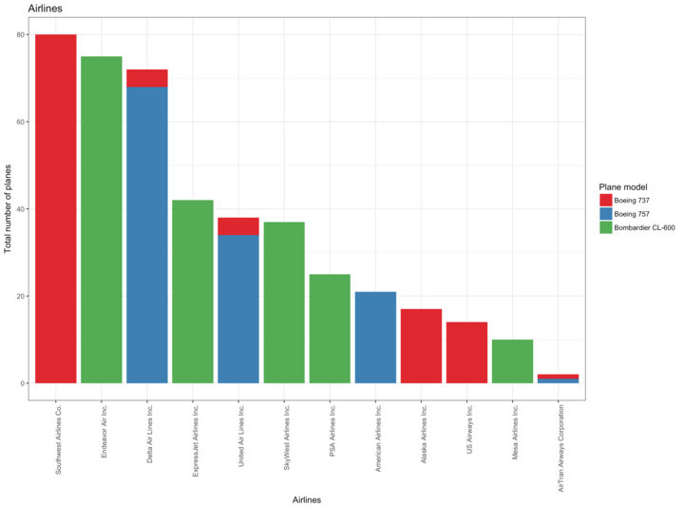
Top Airlines
Southwest Airlines
Endeavor Air Inc.
Delta Air Lines Inc.
© 2016 Think Big, a Teradata Company

Slide 5
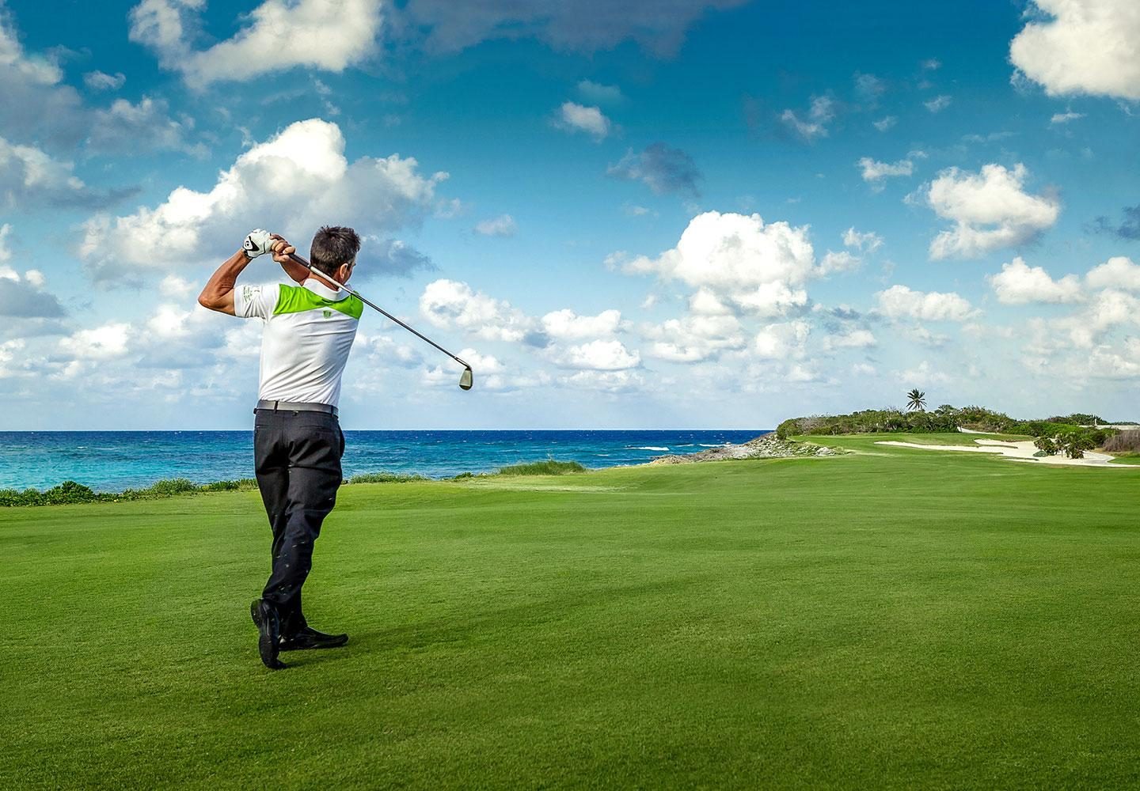



Whom to play golf with
Gary C. Kelly
Ed Bastian
Ryan Gumm
© 2016 Think Big, a Teradata Company

Slide 6
Revenue opportunities
Investments | mln $
R&D | 5
Certs | 3
Total | 8
No. of aircrafts | 433
Margin of 1 transponder | $ 50 k
Potential revenue | $ 21.65 mln
Potential profit | $ 13.65 mln
© 2016 Think Big, a Teradata Company

Slide 7






Methodology
DATA
ANALYSIS
OUTCOME
$$$
© 2016 Think Big, a Teradata Company

Slide 8
Demo

Slide 9
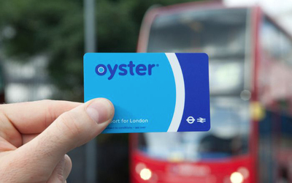
Next Steps

